Slide 1
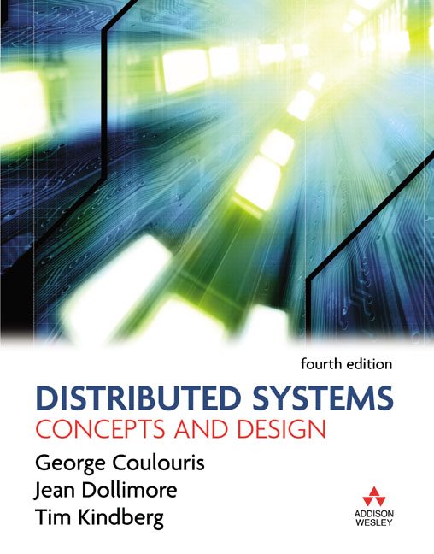
Slides for Chapter 20:
CORBA Case Study
From Coulouris, Dollimore and Kindberg
Distributed Systems:
Concepts and Design
Edition 4, © Addison-Wesley 2005

Slide 2
Figure 20.1
IDL interfaces Shape and ShapeList
struct Rectangle{ 1
long width;
long height;
long x;
long y;
} ;
struct GraphicalObject { 2
string type;
Rectangle enclosing;
boolean isFilled;
};
interface Shape { 3
long getVersion() ;
GraphicalObject getAllState() ; // returns state of the GraphicalObject
};
typedef sequence <Shape, 100> All; 4
interface ShapeList { 5
exception FullException{ }; 6
Shape newShape(in GraphicalObject g) raises (FullException); 7
All allShapes(); // returns sequence of remote object references 8
long getVersion() ;
};

Slide 3
Figure 20.2
Java interfaces generated by idlj from CORBA interface ShapeList
public interface ShapeListOperations {
Shape newShape(GraphicalObject g) throws ShapeListPackage.FullException;
Shape[] allShapes();
int getVersion();
}
public interface ShapeList extends ShapeListOperations, org.omg.CORBA.Object,
org.omg.CORBA.portable.IDLEntity { }

Slide 4
Figure 20.3
ShapeListServant class of the Java server program for CORBA interface ShapeList
import org.omg.CORBA.*;
import org.omg.PortableServer.POA;
class ShapeListServant extends ShapeListPOA {
private POA theRootpoa;
private Shape theList[];
private int version;
private static int n=0;
public ShapeListServant(POA rootpoa){
theRootpoa = rootpoa;
// initialize the other instance variables
}
// continued on the next slide

Slide 5
Figure 20.3 continued
public Shape newShape(GraphicalObject g)
throws ShapeListPackage.FullException { 1
version++;
Shape s = null;
ShapeServant shapeRef = new ShapeServant( g, version);
try {
org.omg.CORBA.Object ref =
theRoopoa.servant_to_reference(shapeRef); 2
s = ShapeHelper.narrow(ref);
} catch (Exception e) {}
if(n >=100) throw new ShapeListPackage.FullException();
theList[n++] = s;
return s;
}
public Shape[] allShapes(){ ... }
public int getVersion() { ... }
}

Slide 6
Figure 20.4 Java class ShapeListServer
import org.omg.CosNaming.*; import org.omg.CosNaming.NamingContextPackage.*;
import org.omg.CORBA.*; import org.omg.PortableServer.*;
public class ShapeListServer {
public static void main(String args[]) {
try{
ORB orb = ORB.init(args, null); 1
POA rootpoa = POAHelper.narrow(orb.resolve_initial_references("RootPOA"));2
rootpoa.the_POAManager().activate(); 3
ShapeListServant SLSRef = new ShapeListServant(rootpoa); 4
org.omg.CORBA.Object ref = rootpoa.servant_to_reference(SLSRef); 5
ShapeList SLRef = ShapeListHelper.narrow(ref);
org.omg.CORBA.Object objRef =orb.resolve_initial_references("NameService");
NamingContext ncRef = NamingContextHelper.narrow(objRef); 6
NameComponent nc = new NameComponent("ShapeList", ""); 7
NameComponent path[] = {nc}; 8
ncRef.rebind(path, SLRef); 9
orb.run(); 10
} catch (Exception e) { ... }
}}

Slide 7
Figure 20.5
Java client program for CORBA interfaces Shape and ShapeList
import org.omg.CosNaming.*;
import org.omg.CosNaming.NamingContextPackage.*;
import org.omg.CORBA.*;
public class ShapeListClient{
public static void main(String args[]) {
try{
ORB orb = ORB.init(args, null); 1
org.omg.CORBA.Object objRef =
orb.resolve_initial_references("NameService");
NamingContext ncRef = NamingContextHelper.narrow(objRef);
NameComponent nc = new NameComponent("ShapeList", "");
NameComponent path [] = { nc };
ShapeList shapeListRef =
ShapeListHelper.narrow(ncRef.resolve(path)); 2
Shape[] sList = shapeListRef.allShapes(); 3
GraphicalObject g = sList[0].getAllState(); 4
} catch(org.omg.CORBA.SystemException e) {...}
}

Slide 8
Figure 20.6
The main components of the CORBA architecture
client
implementation
interface
server
repository
repository
object
skeleton
adapter
client
proxy
ORB
Request
ORB
Servant
program
for A
core
core
A
Reply
or dynamic invocation
or dynamic skeleton

Slide 9
Figure 20.7
IDL module Whiteboard
module Whiteboard {
struct Rectangle{
...} ;
struct GraphicalObject {
...};
interface Shape {
...};
typedef sequence <Shape, 100> All;
interface ShapeList {
...};
};

Slide 10
Figure 20.8
IDL constructed types – 1
Type
Examples
Use
sequence
typedef sequence <Shape, 100> All;
Defines a type for a variable-length
typedef sequence <Shape> All
sequence of elements of a specified
bounded and unbounded sequences
IDL type. An upper bound on the
o
f Shapes
length may be specified.
string
String name;
Defines a sequences of characters,
typedef string<8> SmallString;
terminated by the null character. An
unbounded
and bounded
upper bound on the length may be
sequences of characters
specified.
array
typedef octet uniqueId[12];
Defines a type for a multi-dimensional
typedef GraphicalObject GO[10][8]
fixed-length sequence of elements of a
specified IDL type.
this figure continues on the next slide

Slide 11
Figure 20.8
IDL constructed types – 2
Type
Examples
Use
record
struct GraphicalObject {
Defines a type for a record containing a
string type;
group of related entities. Structs are
Rectangle enclosing;
passed by value in arguments and
boolean isFilled;
results.
};
enumerated
enum Rand
The enumerated type in IDL maps a
(Exp, Number, Name);
type name onto a small set of integer
values.
union
union Exp switch (Rand) {
The IDL discriminated union allows
case Exp: string vote;
one of a given set of types to be passed
case Number: long n;
as an argument. The header is
case Name: string s;
parameterized by an
enum
, which
};
specifies which member is in use.

Slide 12
Page 842
CORBA interoperable object references
IOR format
IDL interface type name
Protocol and address details
Object key
interface repository
IIOP
host domain
port number
adapter name
object name
identifier
name

Slide 13
Figure 20.9
Naming graph in CORBA Naming Service
initial naming context
initial naming context
initial naming context
ShapeList
B
XX
V
P
C
D
E
R
S
T
Q
U

Slide 14
Figure 20.10
Part of the CORBA Naming Service NamingContext interface in IDL
struct NameComponent { string id; string kind; };
typedef sequence <NameComponent> Name;
interface NamingContext {
  void bind (in Name n, in Object obj);
    binds the given name and remote object reference in my context.
  void unbind (in Name n);
    removes an existing binding with the given name.
  void bind_new_context(in Name n);
    creates a new naming context and binds it to a given name in my context.
  Object resolve (in Name n);
    looks up the name in my context and returns its remote object reference.
  void list (in unsigned long how_many, out BindingList bl, out BindingIterator bi);
    returns the names in the bindings in my context.
};

Slide 15
Figure 20.11
CORBA event channels
event channel
supplier
consumer
notification
notification
notification
proxy consumer
proxy supplier

